Slide 1
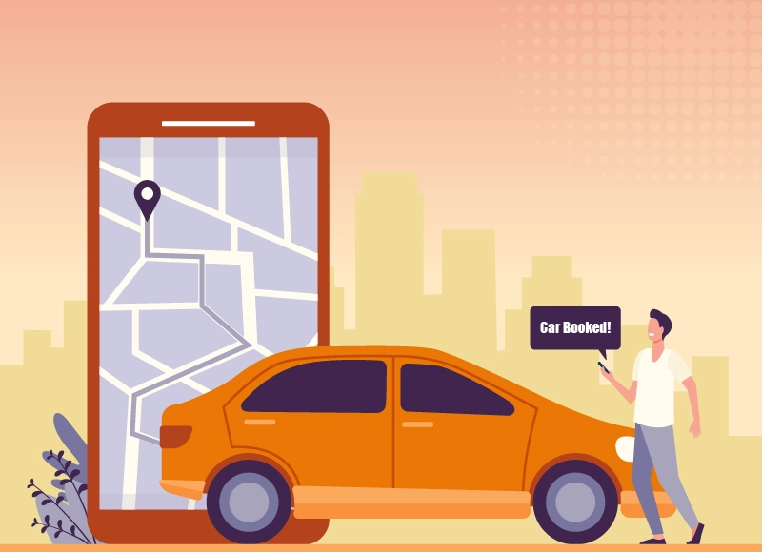

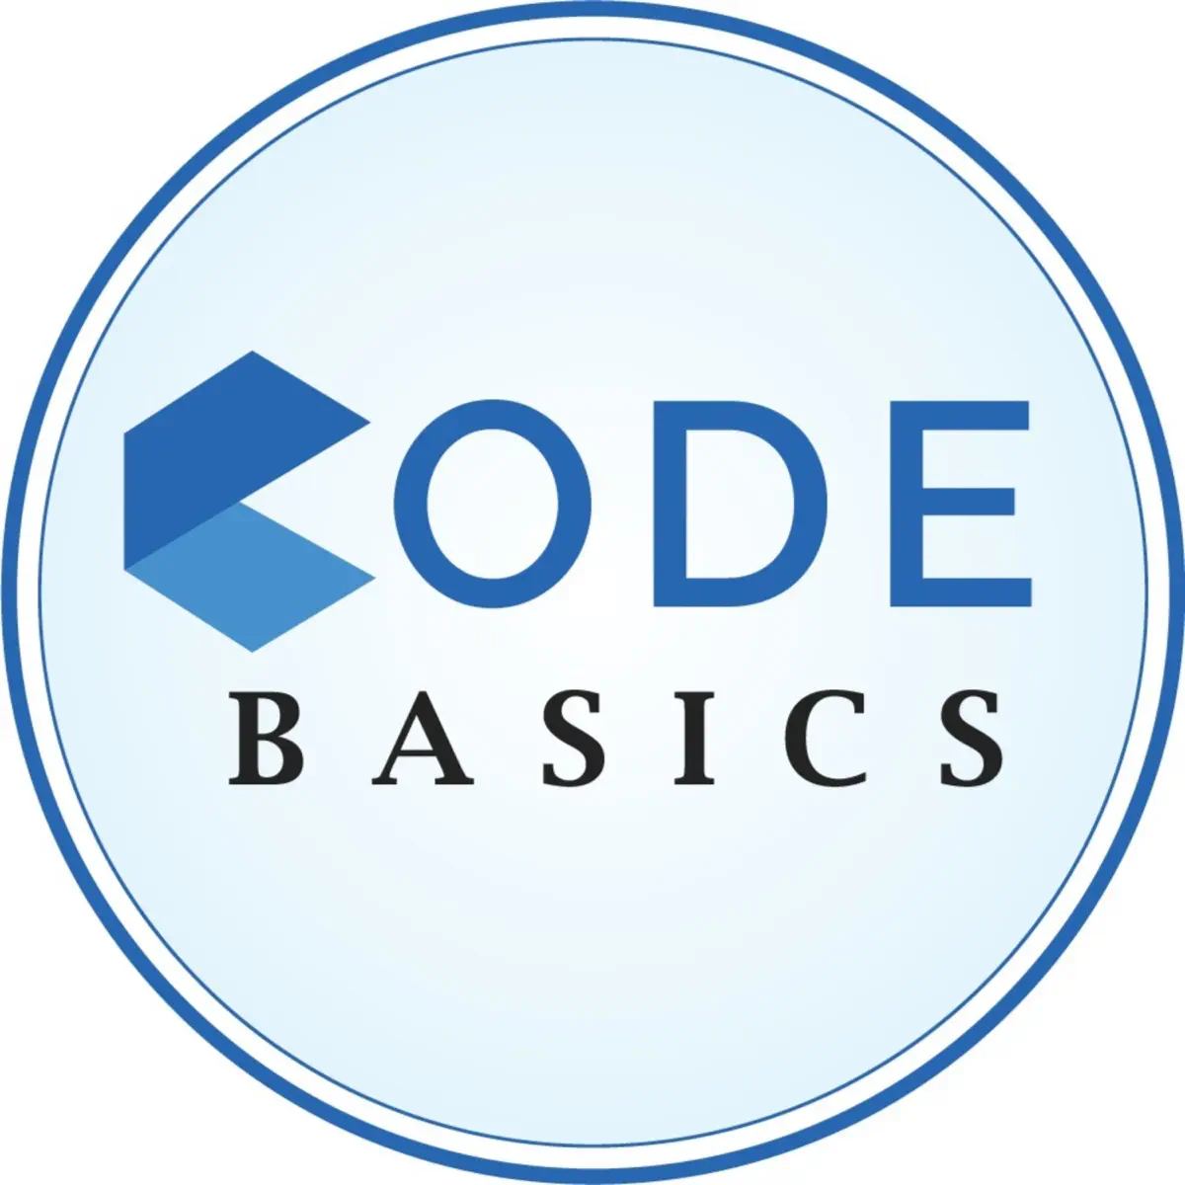

GoodCabs
Performance Analysis
Good Cabs
By: Janaki Patel
Data Analyst

Slide 2
Content
Company Overview
Dashboard Preview
Primary Questions Analysis
Secondary Questions Analysis
Ad-hoc Analysis

Slide 3
Company Overview
About:
Goodcabs is a rapidly growing cab service that has established a strong presence in India's tier-2 cities over the past two years. Unlike many competitors, Goodcabs stands out by empowering local drivers, providing them with sustainable livelihoods, while delivering exceptional service to passengers.
Problem and Solution:
Goodcabs has set ambitious growth and passenger satisfaction targets for 2024. To achieve these objectives, the management team is focusing on key operational and strategic metrics, including Trip Volume, Passenger Satisfaction, Repeat Passenger Rate, Trip Distribution, and Customer Segmentation.
By addressing these challenges and utilizing data-driven strategies, Goodcabs aims to strengthen its market position, expand its presence across new regions, and ensure long-term sustainability. To support these goals, I developed a comprehensive dashboard, providing actionable insights to drive informed business decisions and optimize operations.

Slide 4
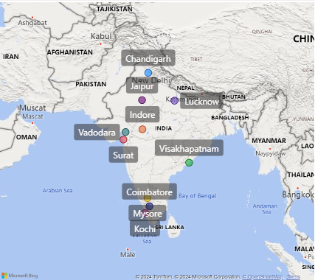
Cities
Visakhapatnam | Tourism
Chandigarh | Tourism
Surat | Business
Vadodara | Business
Mysore | Tourism
Kochi | Tourism
Indore | Tourism
Jaipur | Business
Coimbatore | Business
Lucknow | Business
Analysing 6 months data : Jan 2024 – Jun 2024

Slide 5
Dashboard link

Slide 6
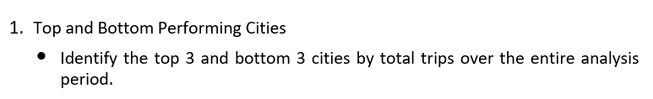
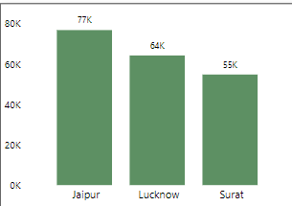
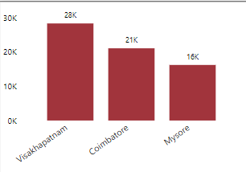
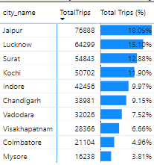
Primary Analysis
-*
Recommendations
Marketing and Promotion in Low-Performing Cities.

Slide 7
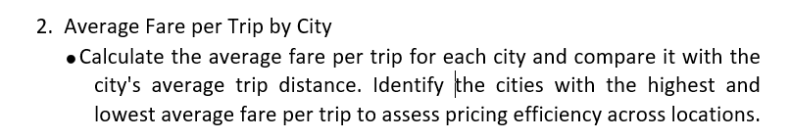
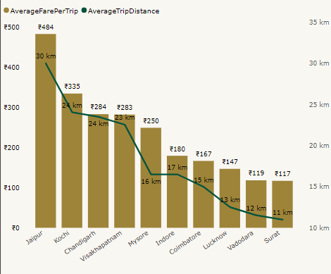
Insights:
Tourist Cities - High Average_Fare_per_trip and Trip_Distance
Business Cities - low Average_Fare_per_trip and Trip_Distance
Recommendations
Market study of under priced Business cities like Surat, Vadodara, and Lucknow.
Introduce dynamic pricing models or gradually increase fares by introducing loyalty rewards or improved ride quality

Slide 8
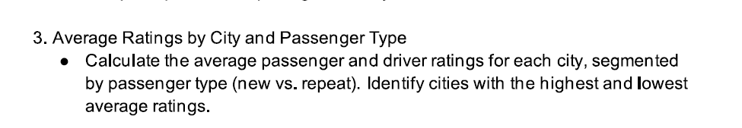
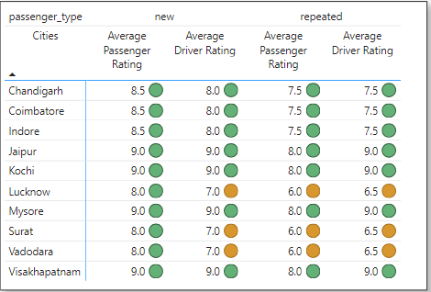
Insights
New passengers consistently receive higher ratings than repeated passengers.
Recommendations
Improving service quality in low-performing cities by addressing driver behaviour, punctuality and ride comfort.

Slide 9
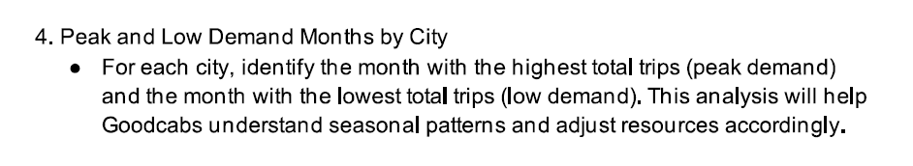
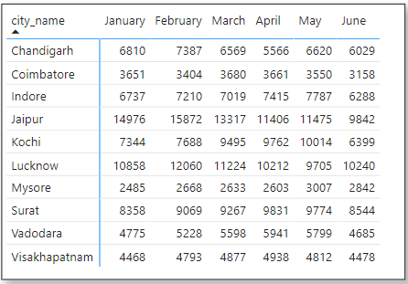
City | Peak Month | Low Demand Month
Jaipur | February | June
Lucknow | February | May
Surat | April | January
Kochi | May | June
Indore | May | June
Chandigarh | February | April
Vadodara | April | June
Visakhapatnam | April | January
Coimbatore | March | June
Mysore | May | January
Insights:
Seasonal factors, such as weather, holidays, or festivals, heavily influence ride demand across the cities
Local factors such as festivals, weather conditions, or work-related travel can create unique patterns for each city.
Recommendations:
Sufficient fleet availability, driver availability and optimized routing to handle the increased demand.
During low-demand periods, introduce targeted marketing campaigns, discounts, or loyalty programs to increase trips count.

Slide 10
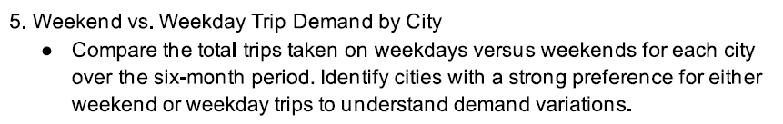
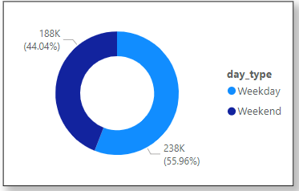
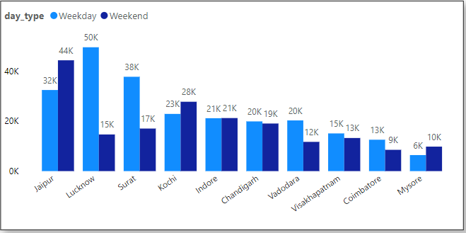
Insights
Jaipur, Kochi and Mysore - Weekend trips as tourist destinations.
Lucknow, Surat, Vadodara and Coimbatore - weekday trips as business hubs.
Indore and Chandigarh a mix of business and leisure travel.
Recommendations
Promotional offers, partnerships with tourist spots.
Corporate partnerships, packages, and enhanced weekday services.

Slide 11
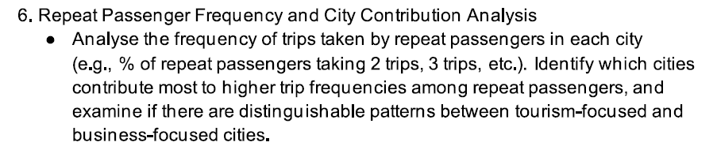
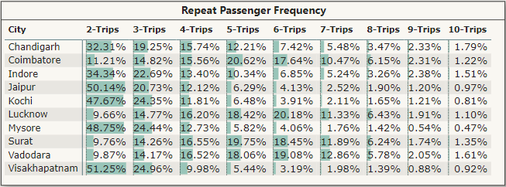
Insights:
Tourism-Centric Cities show High 2-3 trips Short Trip Frequencies
Business-Centric Cities Show Moderate 3-6 trips Visits
Recommendations
For tourism-oriented cities, introduce short-term packages, promotional campaigns.
In business-driven cities, design subscription plans or loyalty rewards for frequent commuters.

Slide 12
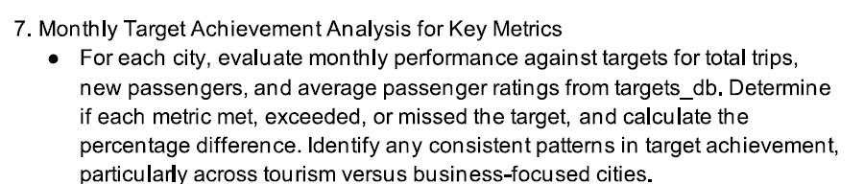
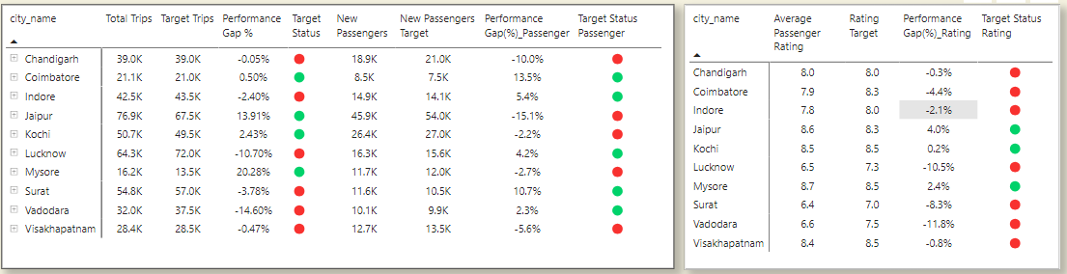
Recommendations
Enhance Driver Training for Business Cities
Collaborate with local travel agencies, introduce special discounts, and enhance app visibility to attract new passengers in tourism-heavy cities.

Slide 13
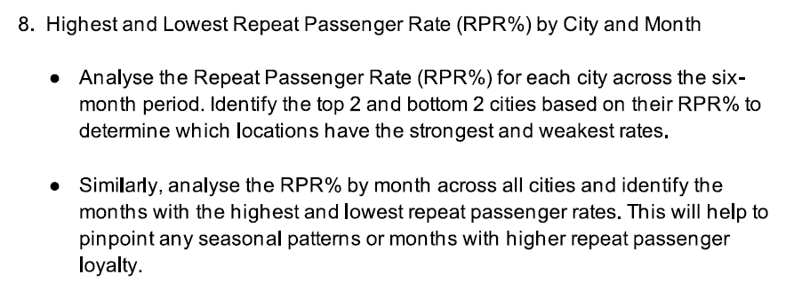
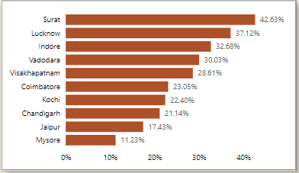
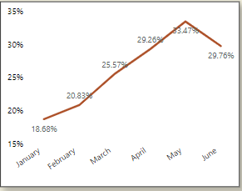

Slide 14
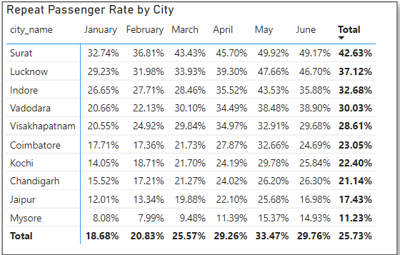
Cities | High RPR | Low RPR
Jaipur | May | January
Lucknow | May | January
Surat | May | January
Kochi | May | January
Indore | May | January
Chandigarh | June | January
Vadodara | June | January
Visakhapatnam | April | January
Coimbatore | May | February
Mysore | May | February
Recommendations:
Low RPR: Targeted marketing campaigns, promotions, or loyalty incentives.
High RPR: Loyalty rewards, premium services or targeted promotions.

Slide 15
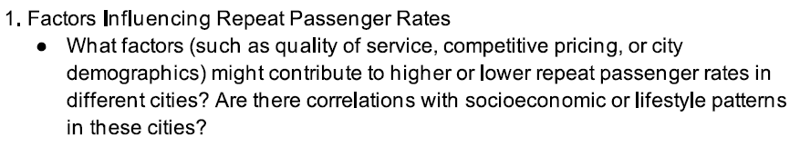
Secondary Analysis
Quality of Service
Professional and polite drivers
Safety and Trust
Driver screenings and vehicle checks.
Ride Availability:
During peak hours and last-minute cancellations
Timeliness:
Punctuality ,Efficient pickups ,Minimal waiting times and Optimized routing
Traffic Conditions
Ride Sharing
Ratings:
Positive ratings for drivers and services.
Local Events and Tourism:
Large-scale events, festivals, or business events
Customer Engagement
Communication via emails or app notifications.
Leverage Technology:
Mobile apps, cashless payments and user-friendly interfaces.
Social Influence and Word of Mouth:
Reviews from peers and social networks.
Pricing Strategies:
Affordable, consistent and transparent pricing models.
Correlations with Socioeconomic and Lifestyle Patterns
Higher Repeat Passenger Rates:
Higher income areas
Young, tech-savvy populations
Dense population
Tourist destination
Business Events
Lower Repeat Passenger Rates:
Low-income areas
Rural or less densely population
High-crime or unsafe areas

Slide 16
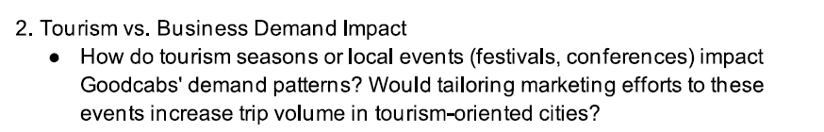
Tailoring Marketing Efforts:
Targeted Promotions
Collaborations with Local Businesses
Engagement with Tourists
Advertising and partnerships
Tourist-friendly services
Seasonal Campaigns
Impact of Tourism Seasons and Local Events
Seasonal Fluctuations(seasons, holidays)
Tourist spots (beaches, mountains, historical site)
Local Events (Festivals, Conferences, Sports Events)
Geographic Variations

Slide 17
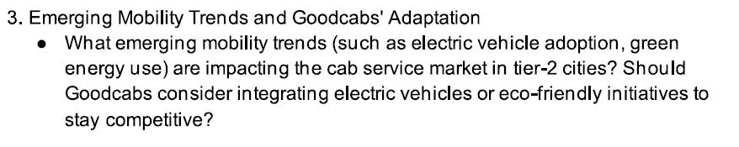
Emerging Mobility Trends
Electric Vehicle Adoption
Solar powered charging station
E-Car-sharing
Mobile applications, real-time tracking, Contactless payments and digital wallets.
Should Goodcabs Consider Integrating Electric Vehicles or Eco-Friendly Initiatives?
Government Regulations and Incentives
Cost Benefits Over Time
Improved Brand Image and Customer Loyalty
Alignment with Future EV Mobility Trends
Partnerships with Shared Mobility Providers

Slide 18
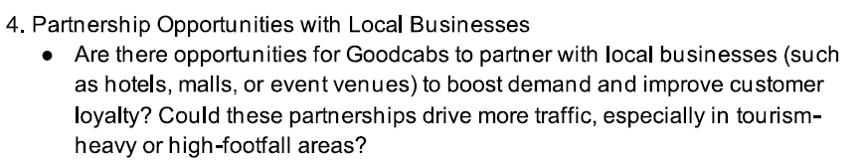
Airport and Hotel Transfers
Shopping Mall Partnerships
Ride Packages for Event Attendees
On-Demand Ride Services
Tour Packages
Dining with Local Restaurants and Cafes
Corporate Transportation Services
Joint Advertising
Social Media Collaborations
Collaborate with universities for students.
Local Markets and Attractions
How these Partnerships Can Drive Traffic and Improve Customer Loyalty:
Boosting Visibility
Customer Loyalty and Retention
Increased Trip Volume During Peak Periods
Increased Demand

Slide 19
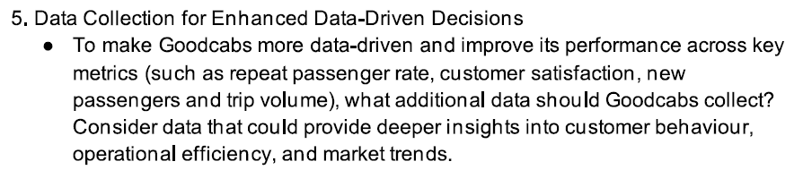
Customer Behaviour Data:
Preferred payment methods
Preferred vehicle types
Preferred ride types (e.g., economy, premium)
Preferred booking channels (app, phone, website)
Cancellation and No-Show Rates
Trip Patterns:
Frequent routes
Peak travel times
Purpose of trips (work, leisure, etc.)
Trip duration
Wait times
Fare breakdown
Customer Feedback:
Ratings and reviews
Feedback surveys
Social media analysis
Driver Performance:
On-time performance
Trip acceptance rates
Pricing and Promotions:
Impact of pricing strategies on demand
Effectiveness of promotional campaigns
Market Trends Data:
Market share
Service offerings
Customer Segmentation:
Demographic data (age, gender, income, occupation)
Two-Wheeler , Auto and Electric Vehicle usage analysis

Slide 20
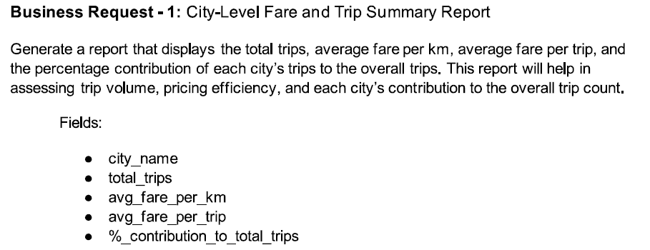
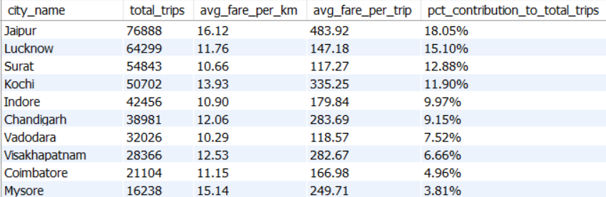
Ad-hoc request
68%

Slide 21
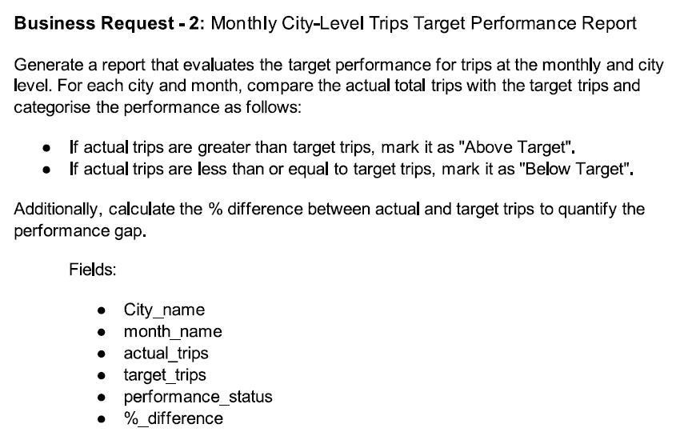
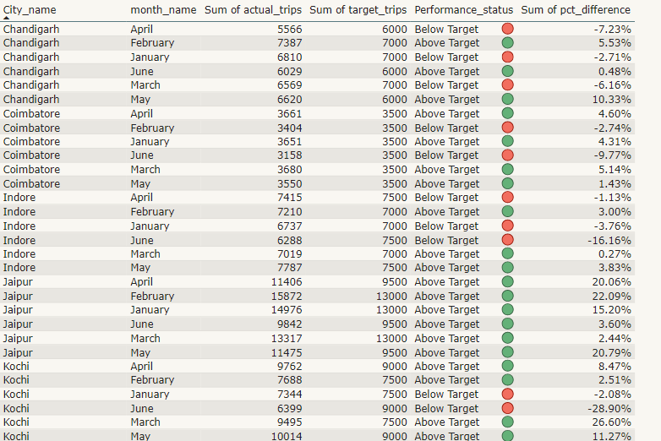
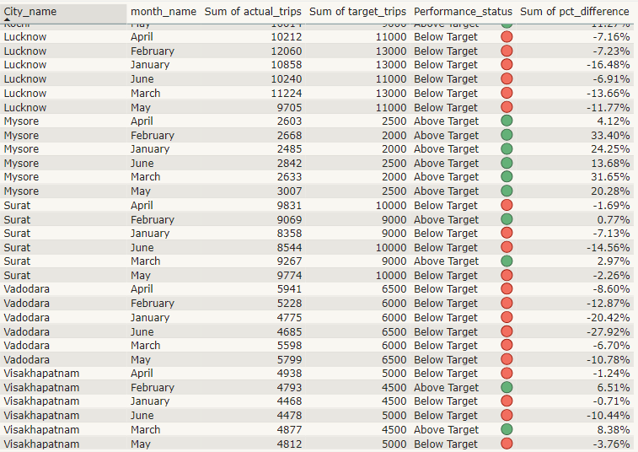
Jaipur, Kochi, and Mysore - exceed target trips
Vadodara , Surat and Lucknow - fall below target

Slide 22
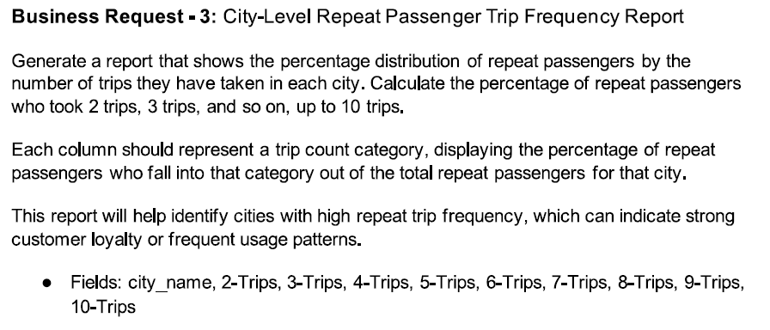
v
v

Slide 23
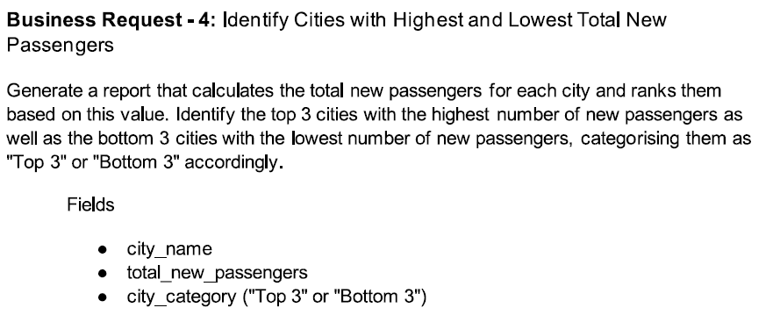
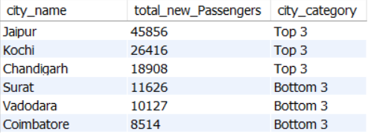

Slide 24
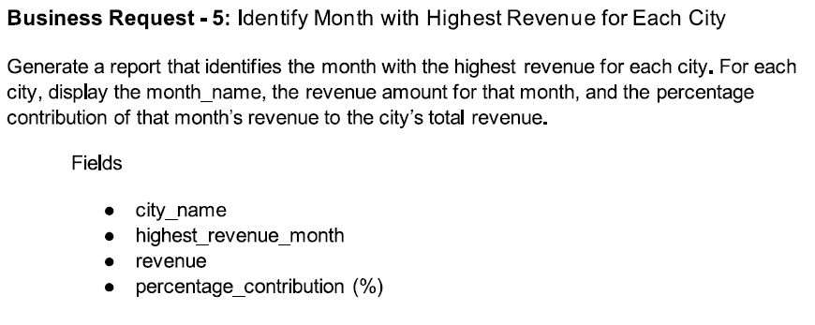
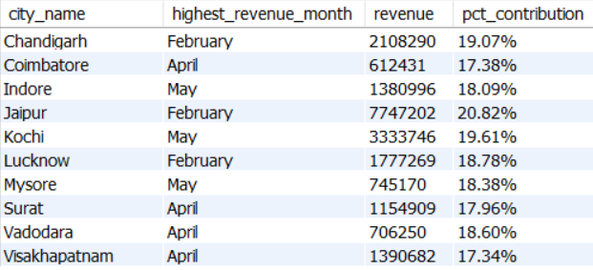
.

Slide 25
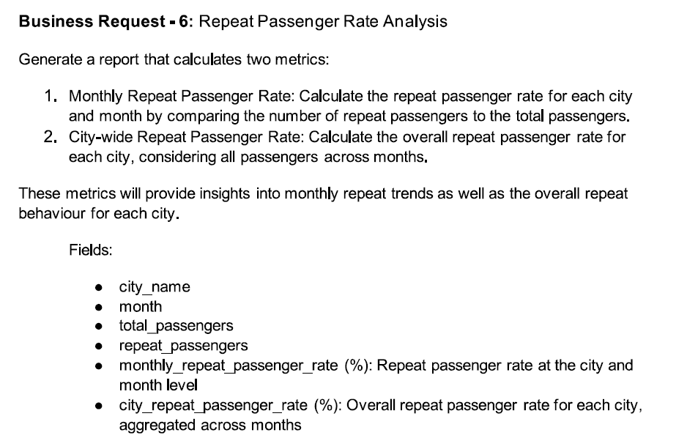
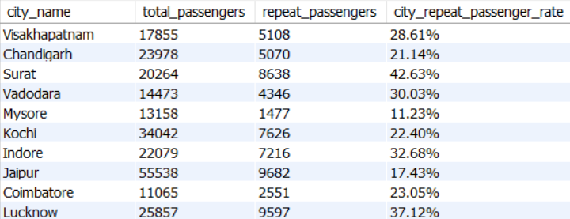

Slide 26
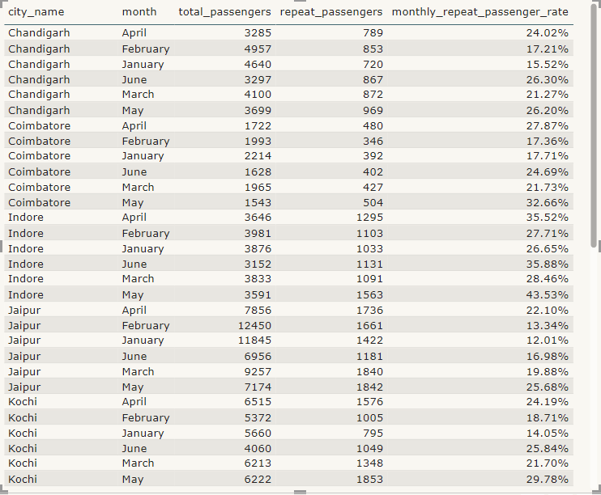
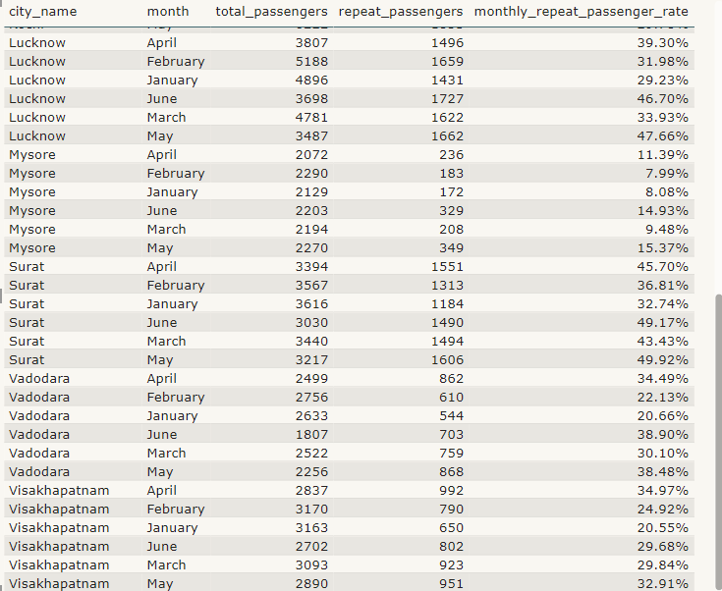

Slide 27
Thank You

